Slide 1
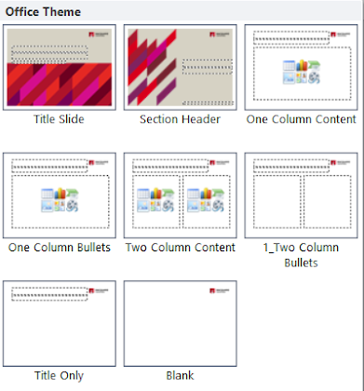
Instructions
BASIC POWERPOINT TEMPLATE
FOOTERS
To update the footer on all slides complete the following:
On any slide go to Insert | Header & Footer
Click in the Footer Section to replace OFFICE | FACULTY | DEPARTMENT with the correct information.
Ensure capitals are used.
Click the checkbox next to Don’t show on title slide.
Click Apply to all.
Be sure to apply the appropriate layout to take full advantage of the template masters provided.
With a slide selected, click the ‘Layout’ button from the ‘Home’ tab.
Select the layout that is most appropriate for the content existing on the slide.
Master slides have been set up for custom slides (shown on right).
A slide has been created in this deck with tables that are editable (no master slide created for these).

Slide 2
Title slide
USE AS FIRST SLIDE IN PRESENTATION

Slide 3
Title slide
USE AS FIRST SLIDE IN PRESENTATION

Slide 4
Title slide
USE AS FIRST SLIDE IN PRESENTATION

Slide 5
Section header
USE FOR TOPIC CHANGES

Slide 6

Agenda layout
USE WHEN AGENDA REQUIRED
This text frame has been designed not to include bullets.
Content is Arial size 18.
Xxxxxxxx
Xxxxxxxxxxxxx

Slide 7
One column content
USE WHEN ONE COLUMN REQUIRED
This text frame has been designed not to include bullets.
Content is Arial size 18.
Select this layout by going to Home | New Slide | One column content.
Change a slide to this layout by going to Home | Layout | One column content. This can be useful when converting presentations from an older style.

Slide 8
One column bullets
USE WHEN ONE COLUMN AND BULLETS REQUIRED
Bullets are set in Arial size 18.
Second-line bullets are Arial size 18.
Third-line bullets are Arial size 18.
Use Tab and Shift + Tab to promote and demote bullets.
Note: Your cursor must be at the beginning of the bullet for this to work.
You can also use the ‘Increase List Level’ and ‘Decrease List Level’ buttons under Home | Paragraph.
Select this layout by going to Home | New Slide | One column bullets.
Change a slide to this layout by going to Home | Layout | One column bullets. This can be useful when converting presentations from an older style.

Slide 9

Team slide
USE WHEN TEAM SLIDE REQUIRED
Text
Text
Text
Text
Text

Slide 10


Staff Profile
USE WHEN STAFF PROFILE REQUIRED
Name
Company
Title
Phone
Email

Slide 11
Organisation chart
FACULTY NAME
Title
Name Surname
Title
Name Surname
Title
Name Surname
Title
Name Surname
Title
Name Surname
Title
Name Surname
Title
Name Surname
Title
Name Surname
Title
Name Surname
Title
Name Surname
Title
Name Surname
Title
Name Surname
Title
Name Surname
Title
Name Surname
Title
Name Surname
Title
Name Surname

Slide 12
Two column content
USE WHEN TWO COLUMNS REQUIRED
COMBINE TEXT AND GRAPHIC
Two column content slide allows you to combine both text and graphic.
Add text to one of the placeholders
In the other placeholder click on the first icon on the second row to browse for a graphic.
This text frame has been designed not to include bullets.
Content is Arial size 18.
This layout is also useful when you want to combine text and a graphic.
Select this layout by going to Home | New Slide | Two column content.
Change a slide to this layout by going to Home | Layout | Two column content. This can be useful when converting presentations from an older style.
This text frame has been designed not to include bullets.
Content is Arial size 18.
This layout is also useful when you want to combine text and a graphic.
Select this layout by going to Home | New Slide | Two column content.
Change a slide to this layout by going to Home | Layout | Two column content. This can be useful when converting presentations from an older style.

Slide 13
Two column bullets
USE WHEN TWO COLUMNS AND BULLETS REQUIRED
Bullets are set in Arial size 18
Second-line bullets are Arial size 18.
Third-line bullets are Arial size 18.
Use Tab and Shift + Tab to promote and demote bullets.
Note: Your cursor must be at the beginning of the bullet for this to work.
You can also use the ‘Increase List Level’ and ‘Decrease List Level’ buttons under Home | Paragraph.
Select this layout by going to Home | New Slide | Two column bullets.
Change a slide to this layout by going to Home | Layout | Two column bullets. This can be useful when converting presentations from an older style.

Slide 14


Two column content
USE WHEN TWO COLUMNS REQUIRED
HEADING | HEADING
Text bullet | Text bullet

Slide 15

Three column content
USE WHEN TWO COLUMNS AND BULLETS REQUIRED
HEADING | HEADING | HEADING
Text bullet | Text bullet | Text bullet

Slide 16





Multiple columns
USE WHEN TWO OR MORE COLUMNS ARE REQUIRED
Heading
Heading
Heading
Heading
Heading
Text
Text
Text
Text
Text

Slide 17






Multiple columns
USE WHEN TWO OR MORE COLUMNS ARE REQUIRED
Text highlight text | Text highlight text | Text highlight text | Text highlight text | Text highlight text | Text highlight text

Slide 18







Multiple columns
USE WHEN TWO OR MORE COLUMNS ARE REQUIRED
 | Text |  | Text |  | Text
 | Text |  | Text |  | Text
 | Text |  | Text |  | Text

Slide 19
Multiple columns
USE WHEN TWO OR MORE COLUMNS ARE REQUIRED
 | Text |  | Text |  | Text
 | Text |  | Text |  | Text
 | Text |  | Text |  | Text

Slide 20
Multiple Image layout
USE WHEN MULTIPLE IMAGES REQUIRED
Image
Image
Image
Text
Text
Text

Slide 21
Image and text layout
USE WHEN IMAGE AND TEXT REQUIRED
Text
Image

Slide 22
Image and text layout
USE WHEN IMAGE AND TEXT REQUIRED
Text
Image

Slide 23


Image and text layout
USE WHEN IMAGE AND TEXT REQUIRED
Insert text
Insert text

Slide 24

Map layout
USE WHEN MAP REQUIRED
American universities:
Bullet point
Bullet point
Australian universities:
Bullet point
Bullet point

Slide 25
Map layout
USE WHEN MAP REQUIRED WITH MULTIPLE DESTINATIONS
UK
Chengdu
Hong Kong
Singapore

Slide 26
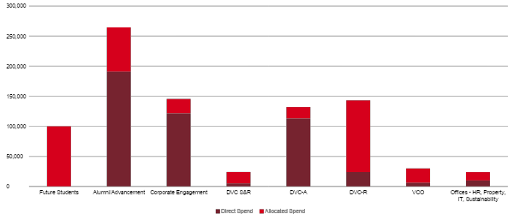
Bar Graph
USE WHEN BAR GRAPH REQUIRED

Slide 27
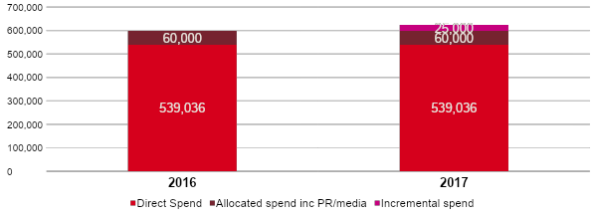
Split Bar Graph
USE WHEN BAR GRAPH REQUIRED
Direct spend
$ spent on activities set out in annual communications plan
Allocated spend
$ allocated from central marketing budget for SM, PR & comms, creative & digital costs
Incremental spend
Additional $ sought to pay for incremental projects. For FHS this is for the establishment and launch of clinic model/rebrand

Slide 28
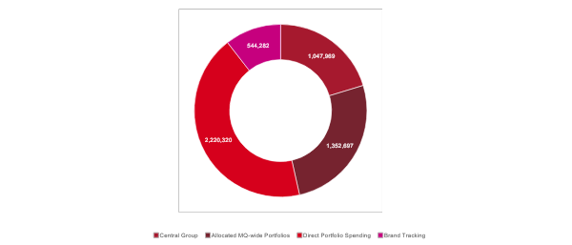
Pie Chart
USE WHEN PIE CHART REQUIRED

Slide 29

Table slide
COPY, PASTE AND MODIFY WHEN TABLE REQUIRED
TABLE STYLES
Due to a limitation in how PowerPoint table styles are applied, it is important to follow the steps below if you need to add extra rows.
Create alternate colour rows:
Move outside the table.
Select the row whose colour you want to copy.
Click the format painter tool on the Home ribbon.
Click the row that needs the new colouring applied.
Table A: Number of application by type of applicant and outcome
 | Access granted in full | Access granted in part | Access refused in full | Information not held | Information already available | Refuse to deal with application | Refuse to confirm deny whether information is held | Application withdrawn
Media | 0 | 0 | 0 | 0 | 0 | 0 | 0 | 0
Members of Parliament | 0 | 0 | 0 | 0 | 0 | 0 | 0 | 0
Private sector business | 0 | 0 | 0 | 0 | 0 | 0 | 0 | 0
Not-for-profit organisations or community groups | 0 | 0 | 0 | 0 | 0 | 0 | 0 | 0
Members of the public (application by legal representation) | 0 | 0 | 0 | 0 | 0 | 0 | 0 | 0
Members of Parliament | 0 | 0 | 0 | 0 | 0 | 0 | 0 | 0

Slide 30
Table slide
COPY, PASTE AND MODIFY WHEN TABLE REQUIRED
TABLE STYLES
Due to a limitation in how PowerPoint table styles are applied, it is important to follow the steps below if you need to add extra rows.
Create alternate colour rows:
Move outside the table.
Select the row whose colour you want to copy.
Click the format painter tool on the Home ribbon.
Click the row that needs the new colouring applied.
Aged analysis at the end of each quarter
Quarter | Current (within due date) $’000 | Less than 30 days overdue $’000 | Between 30 and 60 days overdue $’000 | Between 61 and 90 days overdue $’000 | More than 90 days overdue $’000
March | 8,999 | 8,999 | 8,999 | 8,999 | 8,999
September | 7,790 | 7,790 | 7,790 | 7,790 | 7,790
October | 10,829 | 10,829 | 10,829 | 10,829 | 10,829
November | 7,132 | 7,132 | 7,132 | 7,132 | 7,132
December | 8,999 | 8,999 | 8,999 | 8,999 | 8,999
January | 7,790 | 7,790 | 7,790 | 7,790 | 7,790

Slide 31
Table slide
COPY, PASTE AND MODIFY WHEN TABLE REQUIRED
TABLE STYLES
Due to a limitation in how PowerPoint table styles are applied, it is important to follow the steps below if you need to add extra rows.
Create alternate colour rows:
Move outside the table.
Select the row whose colour you want to copy.
Click the format painter tool on the Home ribbon.
Click the row that needs the new colouring applied.
Accounts due or paid within each quarter
Measure | March | June | July | August
Number of accounts due | 13,977 | 13,977 | 13,977 | 13,977
Number of accounts paid | 24,080 | 24,080 | 24,080 | 24,080
Actual percentage of accounts paid on time | 97% | 97% | 97% | 97%
Actual percentage of accounts paid on time (based on value) | 90% | 90% | 90% | 90%
Dollar amount of accounts paid on time | 13,791 | 13,791 | 13,791 | 13,791
Dollar amount of accounts due for payments | 597 | 597 | 597 | 597
Interest paid | 52,691 | 52,691 | 52,691 | 52,691
Interest paid on overdue accounts | 6,140 | 6,140 | 6,140 | 6,140
Other | 1,675 | 1,675 | 1,675 | 1,675
Total | 154, 446 | 154, 446 | 154, 446 | 154, 446

Slide 32
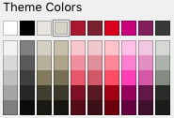
Smart Art slide
EXTERNAL
SMART ART
Due to a limitation in how Smart Art is inserted into presentations, copy and paste this slide as a base.
If the colours don’t follow pattern, click on the shape and choose from these two colours found in the colour palette.
Text
Text
Text
Text
Text
Text
Text
Text
Text
Text
Text
Text

Slide 33



Example of picture slide

Slide 34

Example of picture slide

Slide 35

Heading
SUB-HEADING

Slide 36
Call to action
USE WHEN CALL TO ACTION REQUIRED
Insert text
www.mq.edu.au

Slide 37





































Icons library – Sand, page 1
COPY AND PASTE WHERE NEEDED

Slide 38









































Icons library – Sand, page 2
COPY AND PASTE WHERE NEEDED

Slide 39












Icons library – Sand, page 3
COPY AND PASTE WHERE NEEDED

Slide 40













































Icons library – Charcoal, page 1
COPY AND PASTE WHERE NEEDED

Slide 41












































Icons library – Charcoal, page 2
COPY AND PASTE WHERE NEEDED

Slide 42















Icons library – Charcoal, page 3
COPY AND PASTE WHERE NEEDED

